Slide 1
Use Case Diagram

Slide 2
Use Case Diagram
Use Case Diagrams provide information about the interaction between the use cases and actors.
Use case diagrams show the high level of functionality of the system.
Customers can look at these diagrams and receive a great deal of information about the system.
Use case diagrams are completely based on user’s perspective.

Slide 3
Elements of Use Case Diagram
Use Case
Actor(s)

Slide 4
Use Case
Use case are high level piece of functionality that the system provides.
Use cases are implementation independent high level view of “what” user expects from the system.
It is represented using the symbol

Slide 5
Actor
An actor is anyone or anything that interacts with the system being built.
It is represented by

Slide 6
Types of Use Case
Concrete
Abstract

Slide 7
Concrete Use Case
It is directly initiated by the actor.

Slide 8
Abstract Use Case
Abstract use cases which are initiated by other use case(s) like concrete use case(s).

Slide 9
Types of Actor
Users (of The System)
External Systems
Time

Slide 10
Users(of The System)
Those who use the system or interacts with the system.

Slide 11
External System
Other systems that interact with the system.

Slide 12
Time
Time becomes an actor when the passing of a certain amount of time triggers some event in the system.

Slide 13
Relationship
Communication
Includes

Slide 14
Communication
This is a relationship between a use case and an actor.
It is represented by an arrow as follows: -
The arrow head indicates who initiates the communication.

Slide 15
Includes
It allows one use case to use the functionality provided by another use case.
It is used to model some reusable functionality that is common to two or more use cases.

Slide 16
Extends
It allows one use case to optionally extend the functionality provided by another use case.
It is chosen as an arrow with the word <<extends>>
Concrete
Use Case
Abstract
Use Case
<<extends>>
Withdraws Money
Makes Express Withdrawal

Slide 17
Actor Generalization
It is used to show that several actors have some commonality.
It is needed when one type of actor behaves slightly differently from other type.
Customer
Corporate Customer
Individual Customer

Slide 18
Creating Use Case Diagram
Rational rose designing software tool is used to create use case diagram.
We will open the rational rose XDE (extended development environment) and click on cancel button of the create new model dialog window.
Now you will find that there are two windows: one is rational rose application window and the other is design window (class diagram: logical view/main). Close the design window.
Now on the rational rose application window, you will find the browser panel on the LHS.

Slide 19
Creating Use Case Diagram …
The browser panel contains
Untitled
Use case view
Logical view
Component view
Deployment view
Model properties
Next slide shows the rational rose application window. It has only three menus. They are file, view and help.

Slide 20
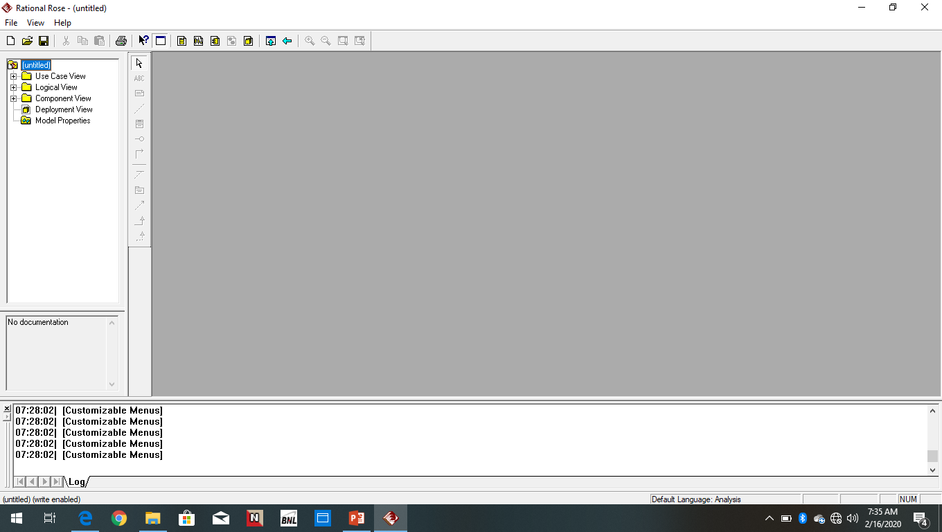
Creating Use Case Diagram …

Slide 21
Use Case Diagram for Library System
Minimum Requirement
Use case(s)
Book Request
Identity Checked
Book Availability
Fine
Actor(s)
Student
Librarian

Slide 22
Use Case Diagram for Library System …
Book Request
Student
Use Case

Slide 23
Use Case Diagram for Library System …
Identity Checked
Student
Use Case

Slide 24
Use Case Diagram for Library System …
Book Availability
Student
Use Case

Slide 25
Use Case Diagram for Library System …
Fine
Student
Use Case

Slide 26
Use Case Diagram for Library System …
Book Request
Librarian
Use Case

Slide 27
Use Case Diagram for Library System …
Identity Checked
Librarian
Use Case

Slide 28
Use Case Diagram for Library System …
Book Availability
Librarian
Use Case

Slide 29
Use Case Diagram for Library System …
Fine
Librarian
Use Case

Slide 30
Use Case Diagram for Library System …
Book Request
Identity Checked
Book Availability
Student
Librarian
Fine

Slide 31
Use Case Diagram for Library System …
Matched
<<e>>
Identity Checked
<<e>>
Not Matched

Slide 32
Use Case Diagram for Library System …
Book Available
<<e>>
Book Availability
<<e>>
Book Not Available

Slide 33
Use Case Diagram for Library System …
Book Issued
<<e>>
Book Available
<<e>>
Book Not Issued

Slide 34
Use Case Diagram for Railway Reservation System
Minimum Requirement
Use case(s)
Request for Ticket
Reservation Counter
Cancellation Counter
Information Counter
Actor(s)
Customer
Railway System

Slide 35
Use Case Diagram for Railway Reservation System …
Request for Ticket
Customer
Use Case

Slide 36
Use Case Diagram for Railway Reservation System …
Reservation Sub System
Customer
Use Case

Slide 37
Use Case Diagram for Railway Reservation System …
Information Counter
Customer
Use Case

Slide 38
Use Case Diagram for Railway Reservation System …
Cancellation Counter
Customer
Use Case

Slide 39
Use Case Diagram for Railway Reservation System …
Request for Ticket
Railway System
Use Case

Slide 40
Use Case Diagram for Railway Reservation System …
Reservation Counter
Railway System
Use Case

Slide 41
Use Case Diagram for Railway Reservation System …
Information Counter
Railway System
Use Case

Slide 42
Use Case Diagram for Railway Reservation System …
Cancellation Counter
Railway System
Use Case

Slide 43
Use Case Diagram for Railway Reservation System …
Request for Ticket
Reservation Counter
Information Counter
Customer
Railway System
Cancellation Counter

Slide 44
Use Case Diagram for Railway Reservation System …
Departure and Destination
<<e>>
<<e>>
Request for Ticket
Cash Payment
<<e>>
Ticket Issued

Slide 45
Use Case Diagram for Railway Reservation System …
Ticket Number
<<e>>
<<e>>
Cancellation
When Ticket Cancelled
<<e>>
Cash Refund

Slide 46
Use Case Diagram for ATM System
Minimum Requirement
Use case(s)
Insert ATM Card
Enter PIN
Valid PIN
Invalid PIN
Eject ATM Card
Submit Request
Balance Enquiry

Slide 47
Use Case Diagram for ATM System …
Withdrawal
Mini Statement
Transfer
Actor(s)
Customer
Card Dispenser
Bank Database

Slide 48
Use Case Diagram for ATM System …
Insert ATM Card
Customer

Slide 49
Use Case Diagram for ATM System …
Submits Request
Customer

Slide 50
Use Case Diagram for ATM System …
Balance Enquiry
Withdrawal
Submits Request
Mini Statement
Customer
Transfer

